Slide 1

Text and Audio processing
By group
Tanmay Kulkarni (25)
Pushpak Maind (28)
Rahul Patil (37)
Vishal Shirke (48)
Project Guide
Prof.Dhananjay Raut

Slide 2

Introduction
Today there is a wide spread talk about improvement of the human interface to the computer. Because no longer people want to sit and read data from the monitor. Since there is a painstaking effort to be taken, this involves strain to their eyes. In this aspect Speech Synthesis is becoming one of the most important steps towards improving the human interface to the computer.
Similarly audio interface allows humans to directly communicate to computer interfaces e.g. Google's search engine which allows the user to directly interact with the commands by speech.

Slide 3

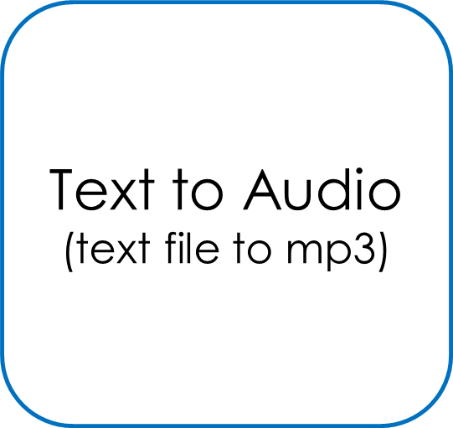
Proposed System
GUI application
Audio To Text
(Wav to text file)
Language Translator
(English to other language)

Slide 4
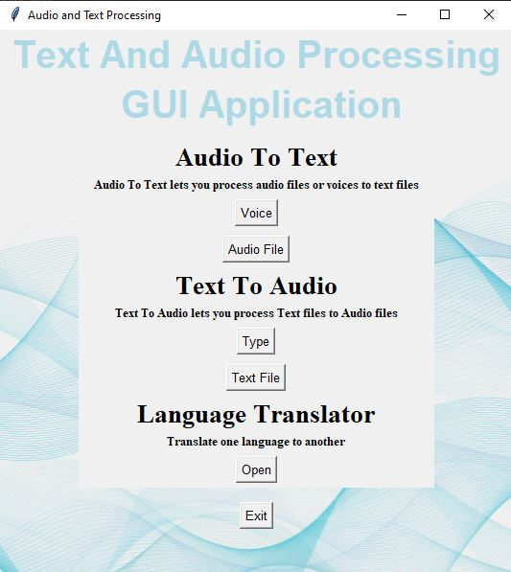
App Home Page
GUI Application of T&A Processing System
Based on Tkinter Package

Slide 5
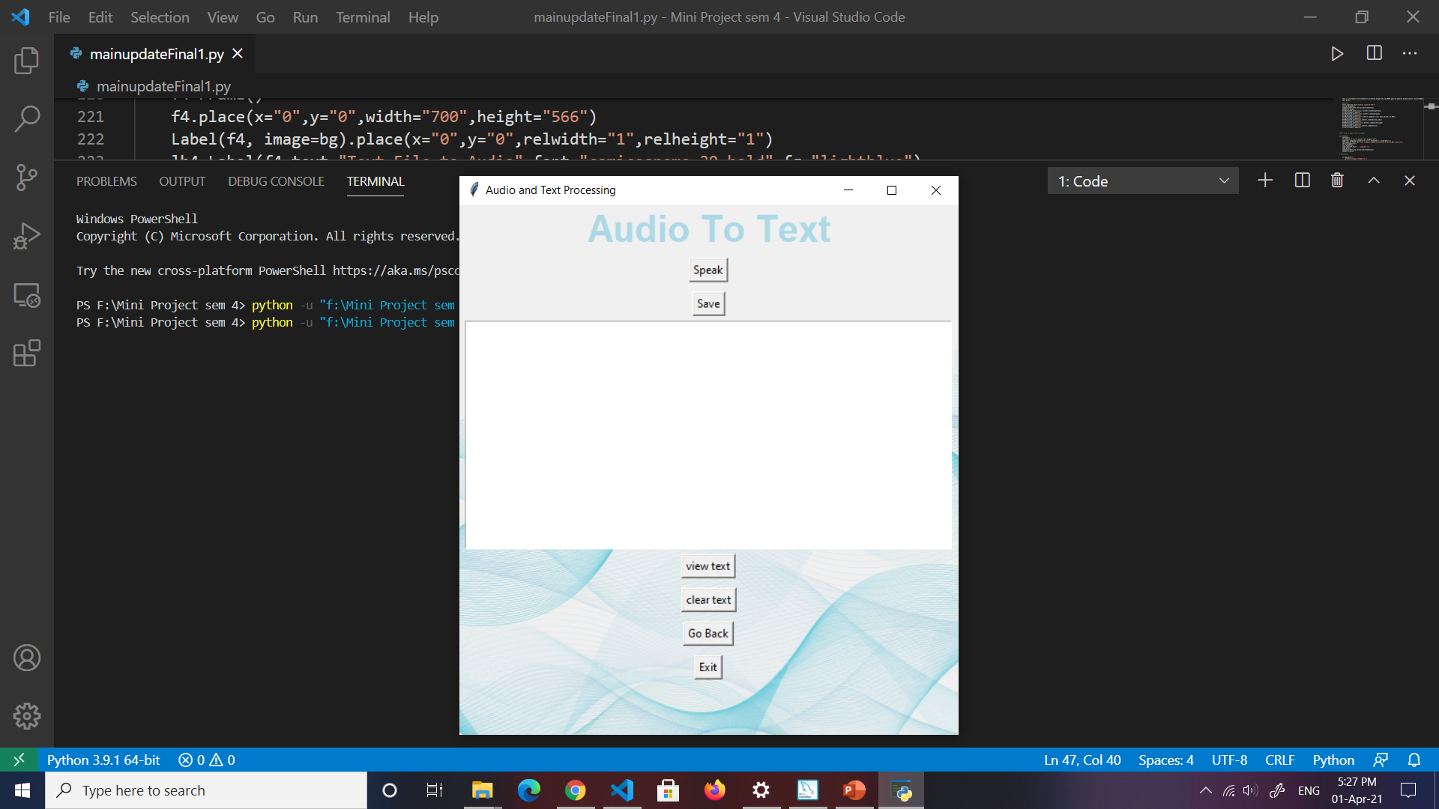
Speech-to-Text
Speech Recognition Module
def recog():
global text
r = sr.Recognizer()
with sr.Microphone() as source:
print('Speak Now: ')
showinfo("python says","Speak Now")
audio = r.listen(source)
print ('Recognition Done!')
showinfo("python says"," Recognition Done! ")
try:
text=r.recognize_google(audio)
except Exception:
print('Sorry...Run Again!')

Slide 6
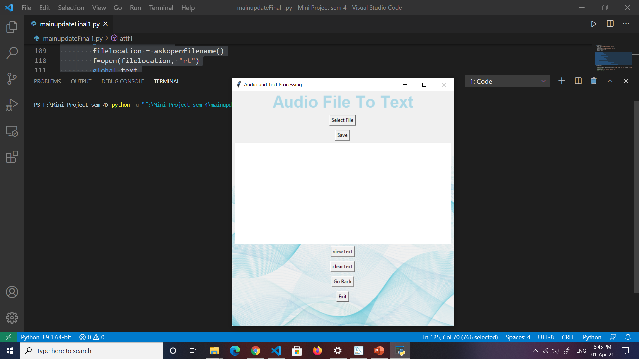
Audio File to Text
PyAudio Module
def selectf():
global filelocation
filelocation = askopenfilename()
f=open(filelocation, "rt")
global text
r = sr.Recognizer()
with sr.AudioFile(filelocation) as source:
audio = r.listen(source)
print('File Recognizing...')
showinfo("python says"," File Recognizing......\n Please Wait!!")
try:
text = r.recognize_google(audio)
print ('Recognition Done!')
showinfo("python says"," Recognition Done! ")
except:
print('You Have Selected Wrong File!')
showinfo("python says"," You Have Selected Wrong File! ")

Slide 7
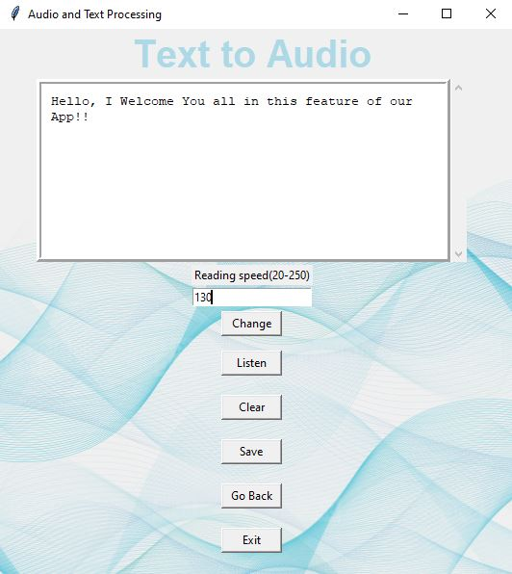
Text-to-Speech
Pyttsx3 Module
def speak():
print(v)
engine = pyttsx3.init("sapi5")
voices = engine.getProperty('voices')
engine.setProperty('voice', voices[0].id)
audio_string = text.get(1.0,END)
engine.setProperty('rate',int(v))
engine.say(audio_string)
engine.runAndWait()
engine.stop()

Slide 8
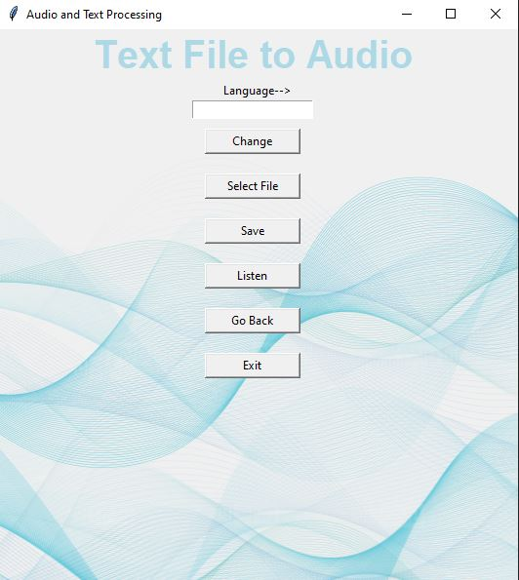
Text File to Audio
gTTS Module
try:
f=open(filelocation, "rt")
x=f.read()
except:
print("Please select .txt file!!")
var = namevalue.get()
myobj = gTTS(text=x, lang=var, slow=False, tld='com')
myobj.save("filename.mp3")
f.close()
playsound("filename.mp3")

Slide 9
!!!Thank You!!!

